Slide 1
Introducing accessibility in 2023: a repository / CRIS perspective
euroCRIS webinar on web accessibility 16 Oct 2023
George Macgregor
University of Glasgow https://purl.org/g3om4c

Slide 2

Web Accessibility Initiative (WAI) & WCAG 1.0
No proliferation of user devices!
W3C HTML 4.0 compliance
Bobby

Slide 3

2023
Few websites / apps can claim 100% accessibility
  100% impossible to achieve…?
Ethos towards making services ‘more accessible’
For repositories…
  Heavy lifting: technical & socio-technical
  But BIG wins beyond human accessibility

Slide 4
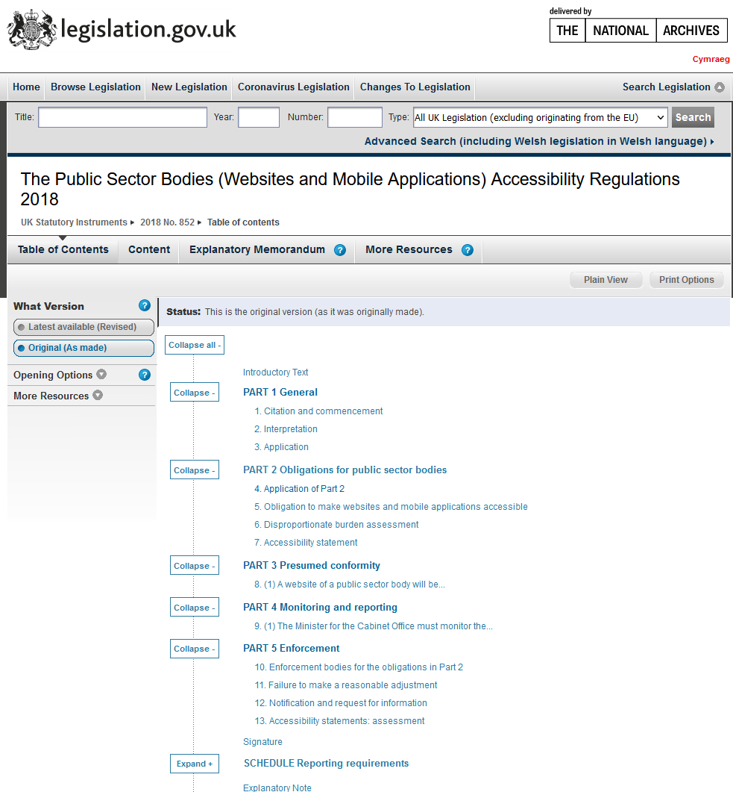
European perspective
Significant change within EU/EEA
  EU Web Accessibility Directive
  ‘Directive (EU) 2016/2102’ - summary
Public sector websites and mobile applications
  Encompasses most (all?!) repositories
  Other services in repository orbit…
Enshrined in local jurisdictions, e.g. UK

Slide 5
EU Web Accessibility Directive
Directive expectations
  Content to be ‘perceivable, operable, understandable and robust’
    4 Principles of WCAG
  Reducing barriers for persons with disabilities (and developers)
Technical expectations
  Web Content Accessibility Guidelines (WCAG) – always evolving
  BUT directive goes beyond WCAG
  Accessibility statements, feedback mechanism for users, monitoring of compliance by local bodies / member states

Slide 6
Relevant exemptions
Directive exemptions
  There are many – worth checking!
  ‘Office file formats’ published prior to September 2018
    Łukasz, Michał, Antoni – PDF documents
    Unique challenges...
  ‘Archive’ definitions surrounding website content
  ‘Heritage collections’

Slide 7
WCAG Principle 1 & 2
Perceivable
  Serving text alternatives (see: Web Accessibility Initiative – Accessible Rich Internet Applications (WAI-ARIA))
  Adaptability of content (meaningful sequence, repurpose, etc.)
  Distinguish (colour, contrast, resizing text)
Operable
  Keyboard accessible
  Easily navigable (pages properly structured, obvious link purposes, skip blocks, etc.)

Slide 8
WCAG Principle 3 & 4
Understandable
  Readable (think: language used, abbreviations)
  Input assistance (e.g. error identification / prevention, help, etc.)
Robust
  The easiest principle from a repository front-end perspective?
  Well formed mark-up, CSS, etc.

Slide 9
Where to start?
Understand the WCAG principles
Repository evaluation and corrective actions
  WAVE Web Accessibility Evaluation Tools
  Browser plugin alongside code inspection
    Not a panacea – only helps to solve UI; not documents
Consider accessibility statement afterwards
  Accessibility an on-going process
  Remember: 100% unachievable

Slide 10
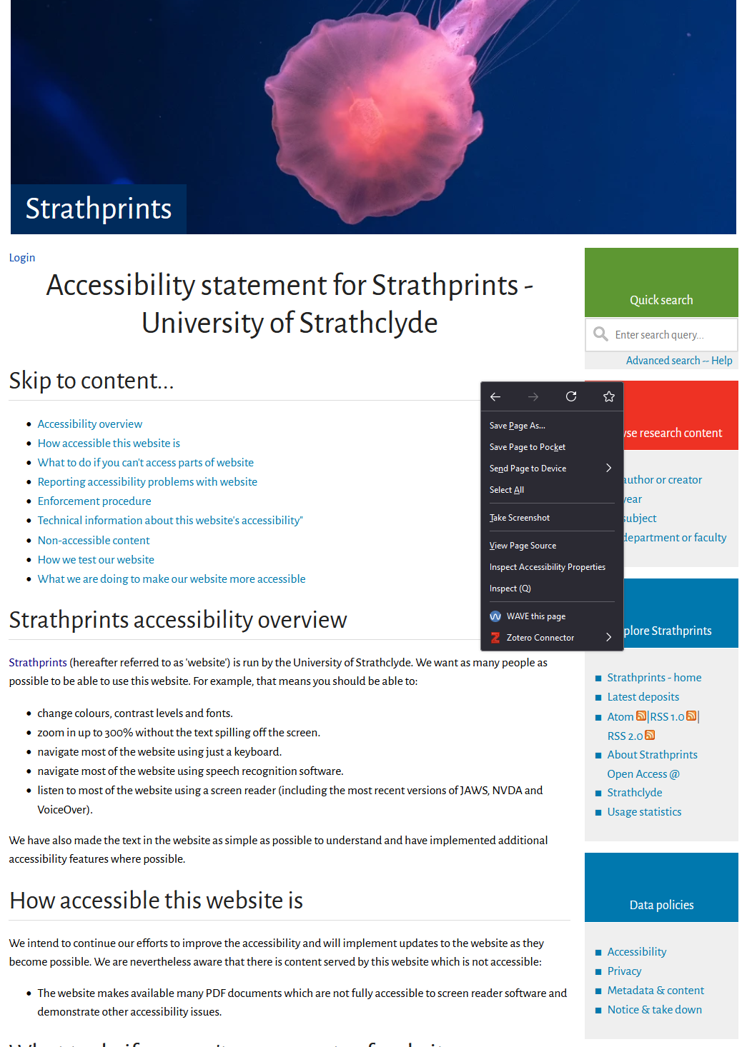
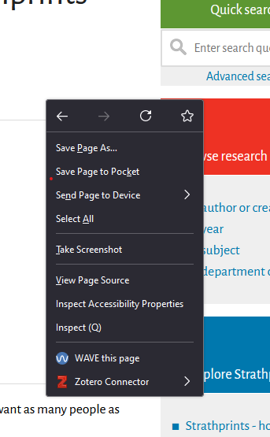

Slide 11
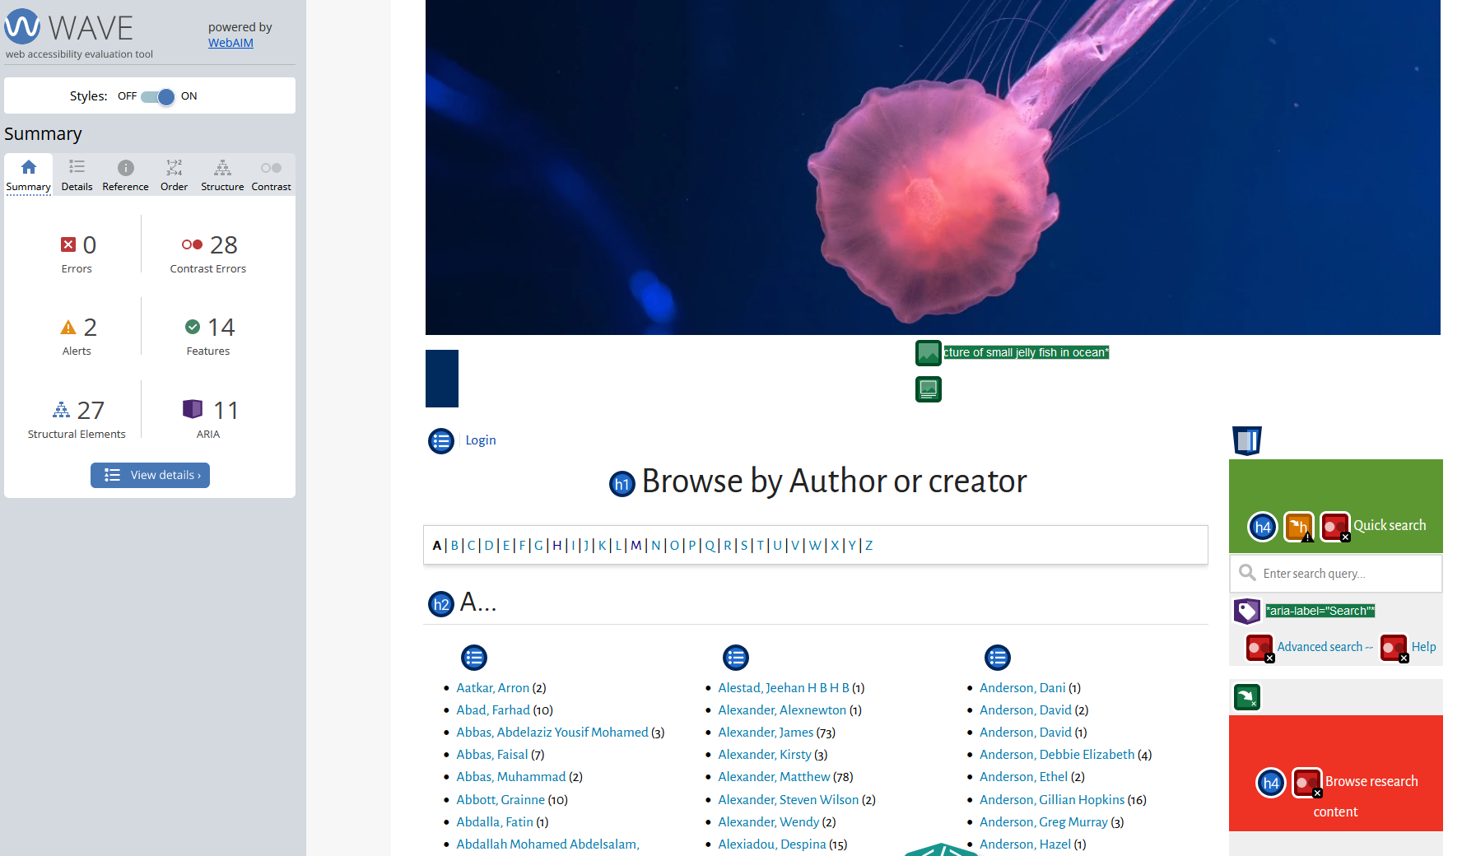

Slide 12
Thanks
Quick questions before Łukasz…?

